Slide 1
life and college success
MSU Denver Persist. & Comp. FLC
Compiled by Cynthia Dormer (w/ lots of help from Dr. Ben Dyhr Dr. Mark Koester)

Slide 2
Why we care about the topic
Federal Reserve Report: College Education Worth $830,000 More Than High School Diploma
For more information: http://www.forbes.com/sites/troyonink/2014/05/05/federal-reserve-college-education-worth-830000-more-than-high-school-diploma/#2b354a5b43e9

Slide 3
What can you do to improve your odds for a rewarding life?
What is “the formula” for success?
How do those around you (family, teachers, community, culture) define success?
What were you told to do to be successful?
If you had write one, what would be your success “formula”?

Slide 4
Some research and considerations.

Slide 5
Do you believe in “productive” struggle?
How so?
Give an example.

Slide 6

The Physiology of Productive Struggle: Brain Plasticity

Slide 7

When learning happens …
A synapse fires
Notes:
When learning happens a synapse fires – electric currents –and create new neurons and connections between neurons.

Slide 8

Plasticity
Learning creates and strengthens synapses
The plasticity of the brain means that new connections grow
If pathways aren’t followed they may be discarded
“Use it or Lose it”
Notes:
The brain is so flexible it is changing by the minute losing, gaining, your brains can be changing in here right now by connections you might make

Slide 9
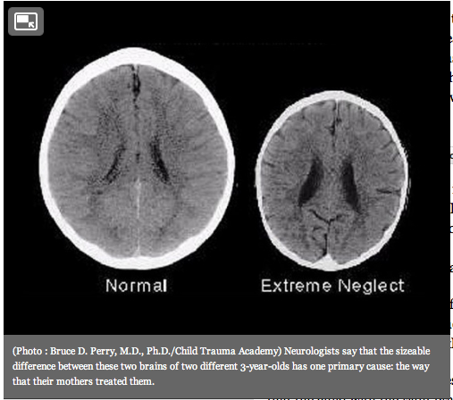
Brain growth

Slide 10
Brain research tells us:
Everyone can learn new things
Mental growth is a little like muscle growth
Difficult material helps students “work out” their brains on a regular basis just like regular exercise is required to improve our physical health.

Slide 11
Effort (brain workouts)
Is effort enough for success? Is this the formula?
Why or why not?
Give an example.

Slide 12
Carol Dweck: Mindset
Mindset: The New Psychology of Success
Fixed - subject ability is a “gift”
Growth – ability grows with experience
Affects students from across the achievement spectrum
“If you think you can,
or you think you can’t, you’re right.”

Slide 13
Effort + Good Strategies including Mindset
Is this enough for success?
Is this the formula?
What else should be in the formula?

Slide 14
Getting help from others
Is this also a key element of the success formula?

Slide 15
Effort + Good Strategies + Getting Help from Others
Have we got the formula now?
What else would you add?

Slide 16
Informed purpose
Purpose means that you’ve got some really good reasons you’re pursuing the degree you’re pursuing.
Informed means you’ve done your research and know what you’ll need to do, while in college and after, to have a successful (as defined by you) life.
Is this important enough to put into our formula?

Slide 17
Informed Purpose+ Effort + Good Strategies + Help From Others
What parts of the formula are you good at applying?
What parts could you apply better?
What is your plan for this class?
For your degree?
Career?

Slide 18
For extra credit, for assignment 2
Write a message of advice for future students about success.
Book an advising appointment with me or your primary advisor to go over your:
Plan for this class
Degree plan
Career plans
Turn in, in the assignment 2 section, a document with your advice for others and your plans.

